Slide 1
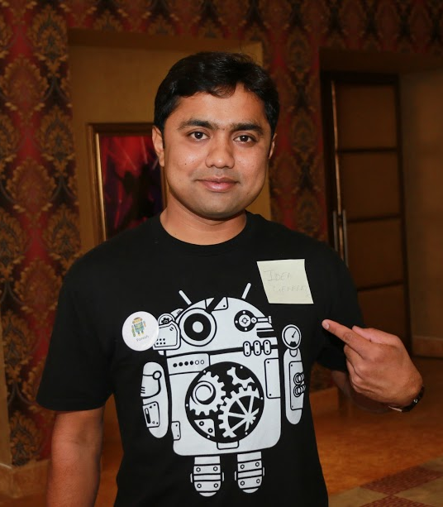

An Ultimate Guide to
Build Tech Resume
Paresh Mayani
Co-Founder / CEO, SolGuruz
India

Slide 2

@pareshmayani

Slide 3
Fact Things

Slide 4
Fact Things
There are hundreds of applicants for each jobs

Slide 5
Fact Things
There are hundreds of applicants for each jobs
No one is having time to read every single lines of your resume

Slide 6
Fact Things
There are hundreds of applicants for each jobs
Don’t fake things in your resume
No one is having time to read every single lines of your resume

Slide 7
Fact Things
There are hundreds of applicants for each jobs
Don’t fake things in your resume
No one is having time to read every single lines of your resume
Experience matters

Slide 8
Resume Basics

Slide 9
Resume Basics
Include your contact information at top
Don’t copy/paste the objective statement
Resume format should be PDF
1 page for interns, 2-3 pages for the experienced candidates
Use bullet points rather than long paragraphs
Don’t put funky design/styles, rather follow the simple and consistent fonts, colors and sizing

Slide 10
Important Tips

Slide 11
Important Tips
List out things mentioned below, recent one at the top
Education Qualifications
Programming languages and technical skills
Employment experience
Projects
Achievements and accomplishments

Slide 12
Important Tips
List out projects, the recent one first
List out CHALLENGES tackled,
team size,
achievements,
responsibility managed
Use managed, delivered, achieved, developed, optimised, troubleshooted, etc.

Slide 13
Resume Templates

Slide 14
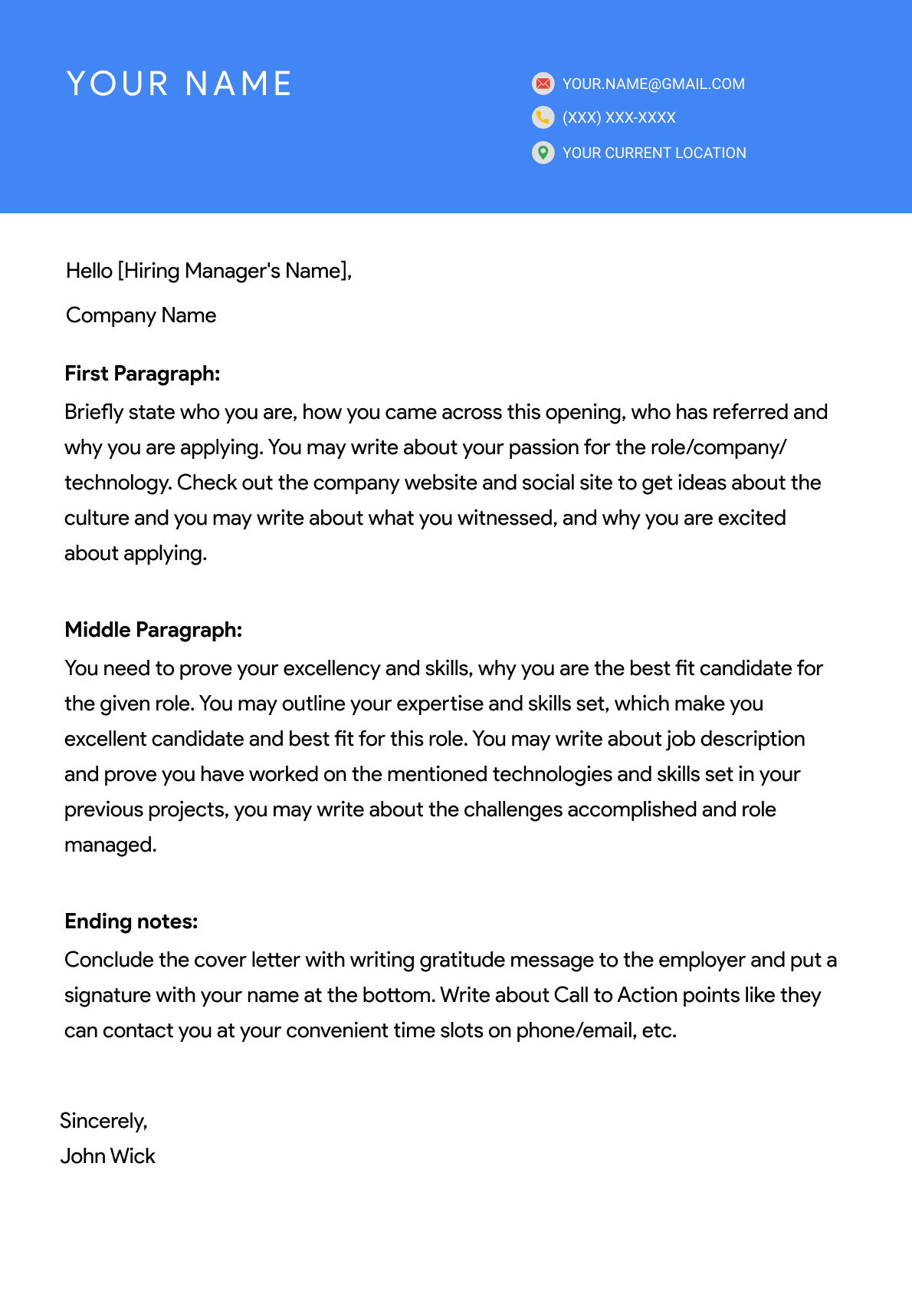
Cover Page

Slide 15
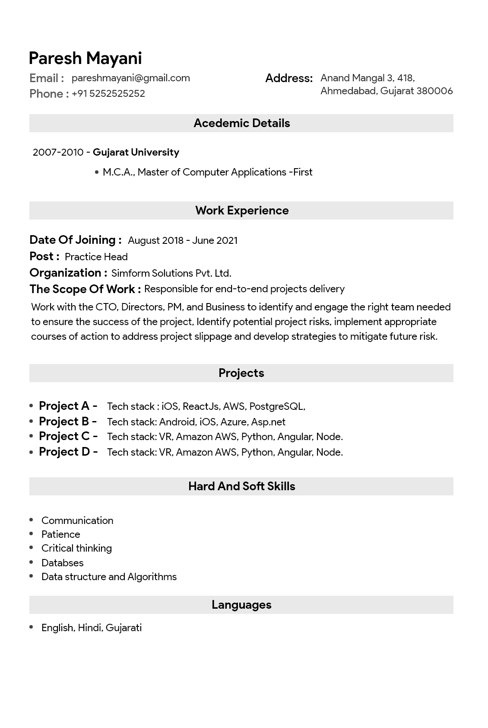
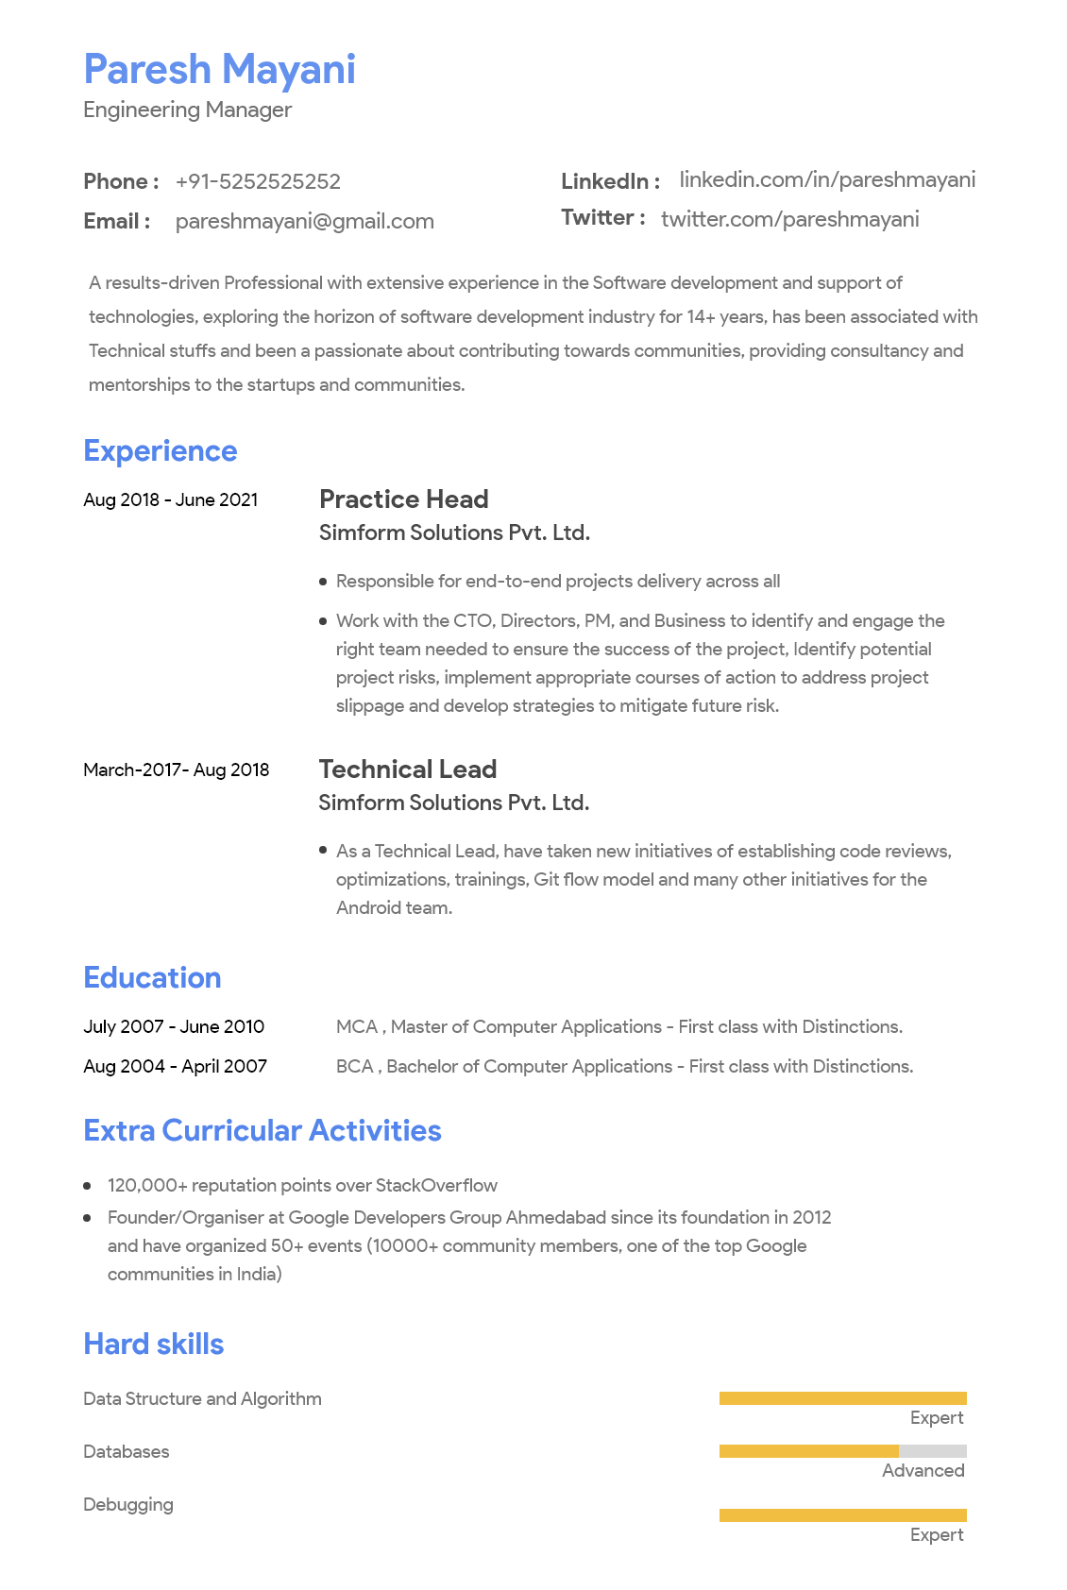

Slide 16
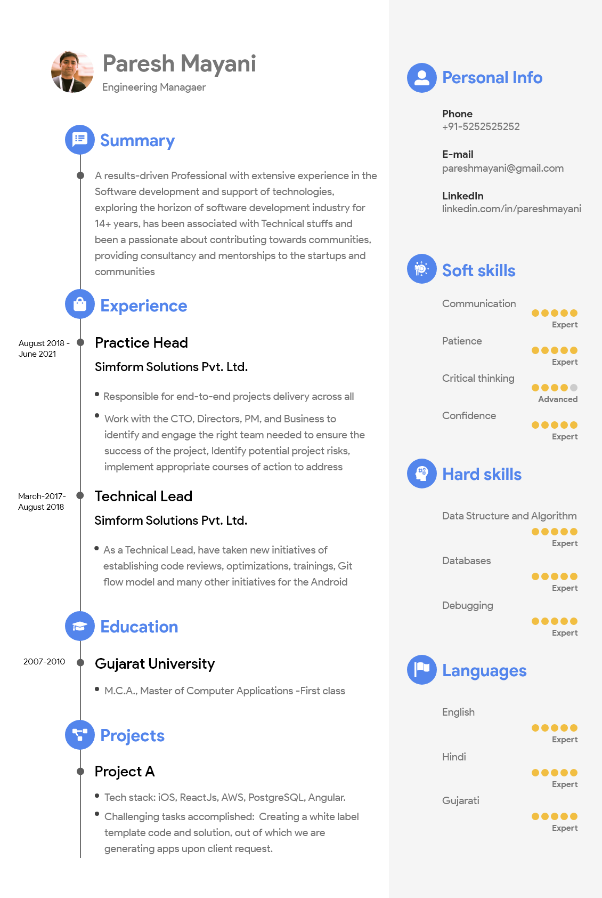

Slide 17
How to Stand apart
from Crowd

Slide 18
“If you want to Stand out from the Crowd,
Give People
A Reason
Not to Forget You”
Richard Branson

Slide 19

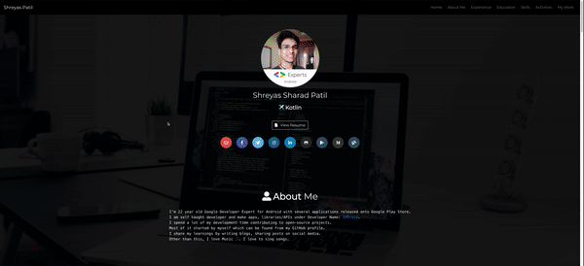
Eye opener tips
Showcase/Practice your tech skills by building online portfolio website or applications
Many companies are offering either FREE or Discounted plan for the Students
There are free domains and Hosting available
Like Github pages http://patilshreyas.github.io
Firebase hosting, Netlify, Wordpress
https://shreyaspatil.dev/

Slide 20
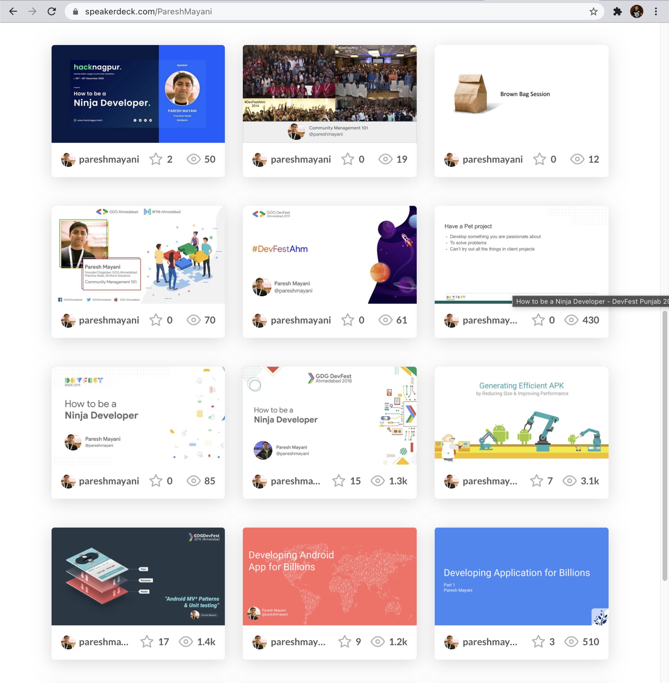
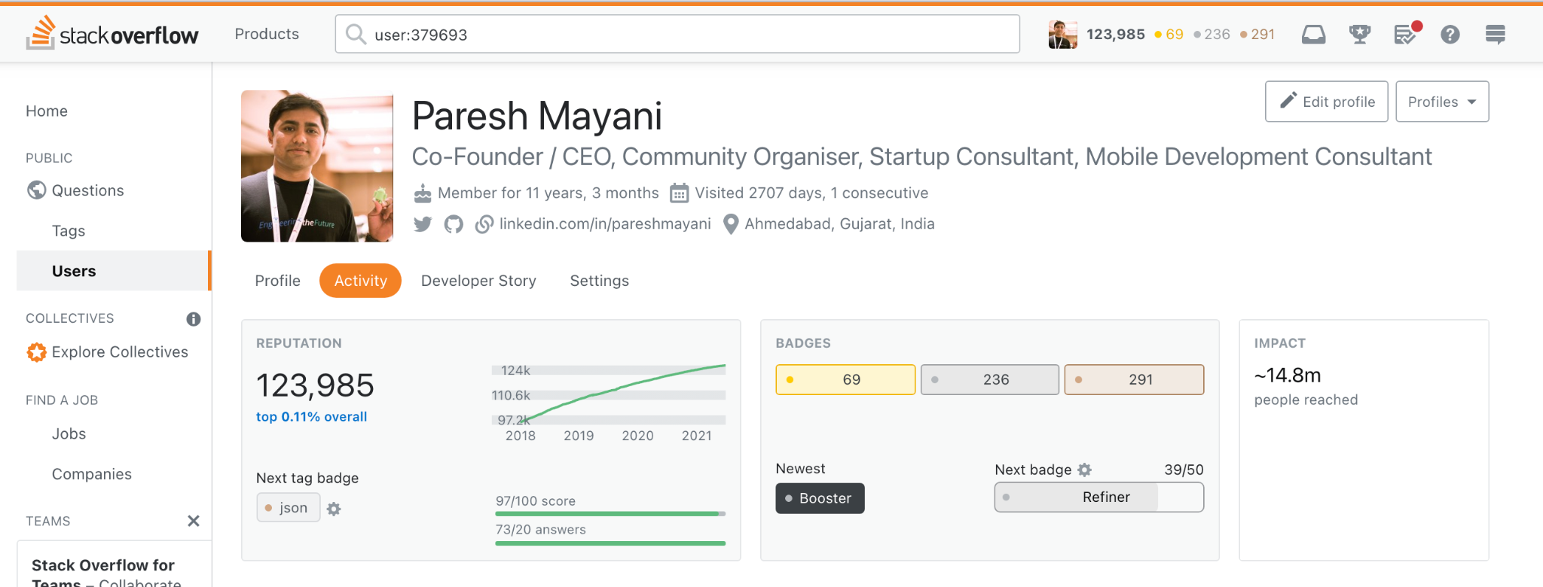
Eye opener tips
Build and Showcase the things you are passionate about by listing GitHub, StackOverflow, Blogs, videos, talks, presentations, white papers, CodeChef, HackerRank, GeeksForGeeks, etc.

Slide 21
Eye opener tips
Showcase the design skills by building design portfolio over Dribbble, Behance
Build and Showcase the impactful things like research, teaching experience, pet projects, patents, publications, etc
Take part in the events in person, virtual. Believe me, there is a lot of learnings (Be it team management, contents, team work, tasks management, and more important Time management)
Do online courses and certifications, build small examples and apps, and push it over store, GitHub, etc.

Slide 22
“Build Practical demos/examples, push it over Store/Web/Github, and interact/learn with the community”

Slide 23
Bonus Tips

Slide 24
Bonus Tips
Do internships, build pet projects, learn by doing practicals and sharpen your tech skills

Slide 25
Bonus Tips
Do internships, build pet projects, learn by doing practicals and sharpen your tech skills
Always write custom cover letter for the job/role you are applying

Slide 26
Bonus Tips
Create and keep the resumes ready for the different roles. For e.g. I used to keep for Engineering Manager, Developer Relations, Program Manager
Do internships, build pet projects, learn by doing practicals and sharpen your tech skills
Always write custom cover letter for the job/role you are applying

Slide 27
Bonus Tips
Create and keep the resumes ready for the different roles. For e.g. I used to keep for Engineering Manager, Developer Relations, Program Manager
Do internships, build pet projects, learn by doing practicals and sharpen your tech skills
Always write custom cover letter for the job/role you are applying
Take part in the Hacktoberfest by making the open-source contribution

Slide 28
How To be a Ninja Developer
For learning and knowing all other activities that you should be doing right from your college days or while doing engineering job:
Refer my presentation/talk:
SpeakerDeck : bit.ly/ninja-developer-21
Youtube - https://bit.ly/ninja-developer-2021-YT

Slide 29
Stay Passionate,
Keep Learning,
Keep Pushing,
Keep Achieving,
Keep crossing limits
Repeat from Step 1

Slide 30

Time’s up
Questions in the comments below
👇
Source: https://in.pinterest.com/pin/93590498485832688/

Slide 31
நன்றி!
ధన్యవాదాలు!
ধন্যবাদ!
Dank je!
Faleminderit!
നന്ദി!
توهان جي مهرباني!
धन्यवाद!
Ευχαριστώ!
ਤੁਹਾਡਾ ਧੰਨਵਾਦ!
谢谢！
ありがとうございました！
Thank you!
ขอขอบคุณ!
À ringrazià ti!
آپ کا شکریہ!
આભાર!
ကျေးဇူးတင်ပါတယ်!
Gràcies!
ಧನ್ಯವಾದ!
Paresh Mayani
Co-Founder / CEO, SolGuruz
India

